Slide 1

Chapter 3
Dynamic Programming
Divesh Aggarwal
School of Computing
Department of Computer Science

Slide 2
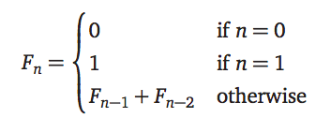
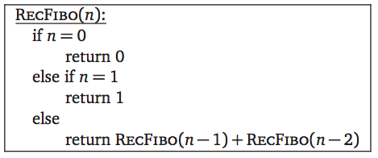
Backtracking Algorithm for Fibonacci Sequence
Suppose we want to compute F_{n} given by the following recurrence

Slide 3
Backtracking can be slow
T(0) = 1, T(1) = 1, T(n) = T(n-1) + T(n-2) + 1
T(n) > 2 T(n-2)
> 2² T(n-4)
.
.
.
> 2^{n/2} T(0) = 2^{n/2}
Can we speed up this algorithm?

Slide 4
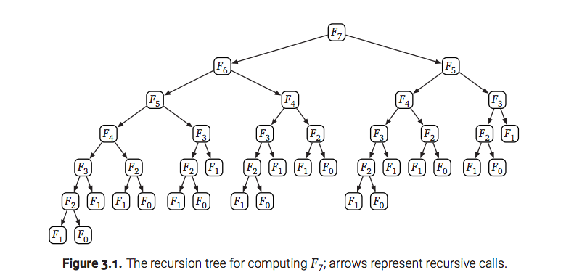
Backtracking algorithm repeats computation

Slide 5
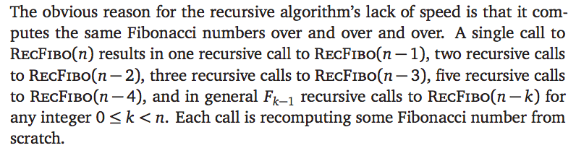
Backtracking algorithm repeats computation

Slide 6
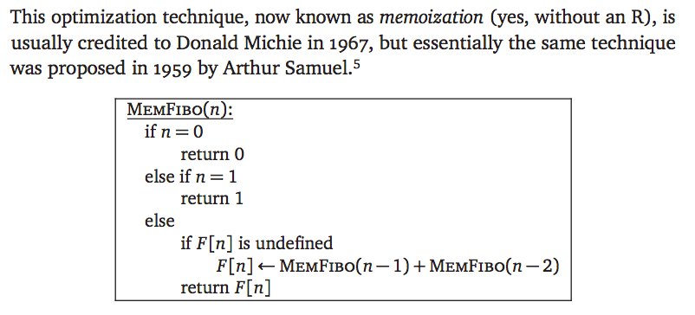
Memo(r)ization: Remember everything
Why memoization without an “r”?

Slide 7
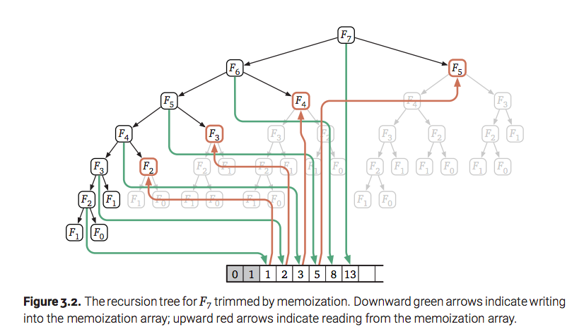
Memoization trims the recursion tree

Slide 8
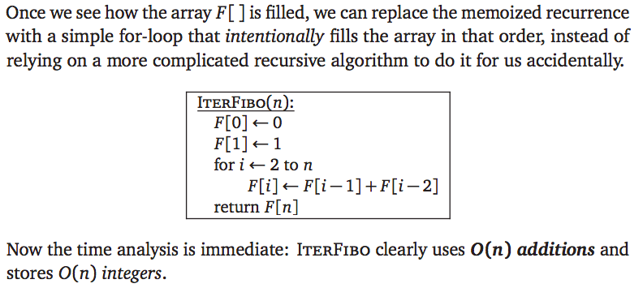
Dynamic Programming: Fill Deliberately

Slide 9
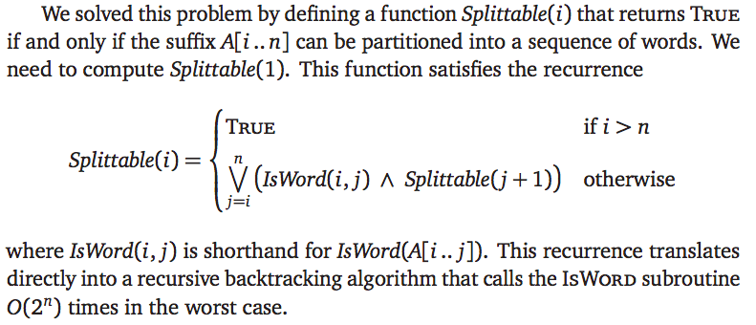
Example: Text Segmentation
For our next dynamic programming algorithm, let’s consider the text segmentation problem from the previous chapter. We are given a string A[1, …, n] , and we want to know whether A can be partitioned into a sequence of words.

Slide 10
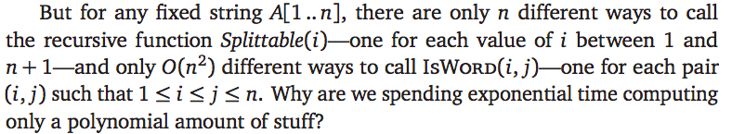
Backtracking repeats computation

Slide 11
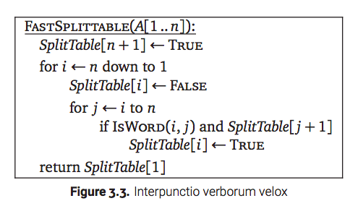
Dynamic Programming solution
T(n) = O(n²) calls to ISWORD

Slide 12


Slide 13
Greed is almost never good
If we’re incredibly lucky, we can bypass all the recurrences and tables and so forth, and solve the problem using a greedy algorithm.
Greedy algorithm looks at only one branch of the recursion tree
For example, a greedy algorithm for the text segmentation problem might find the shortest (or, if you prefer, longest) prefix of the input string that is a word, accept that prefix as the first word in the segmentation, and then recursively segment the remaining suffix of the input string
Similarly, a greedy algorithm for the longest increasing subsequence problem might look for the smallest element of the input array, accept that element as the start of the target subsequence, and then recursively look for the longest increasing subsequence to the right of that element.
If these sound like stupid hacks to you, pat yourself on the back; these aren’t even close to correct solutions.

Slide 14
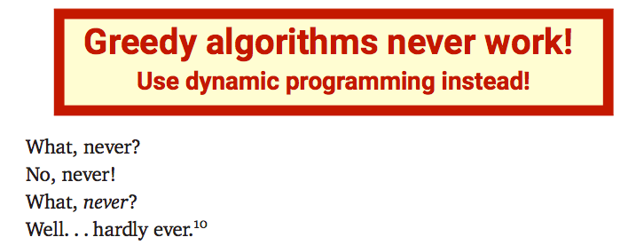

Greed is not good

Slide 15
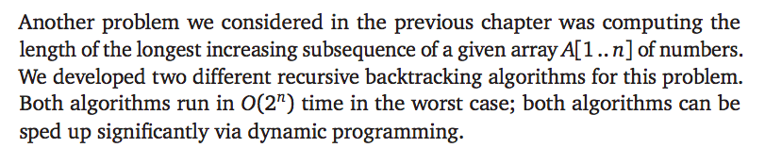
Longest increasing subsequence

Slide 16
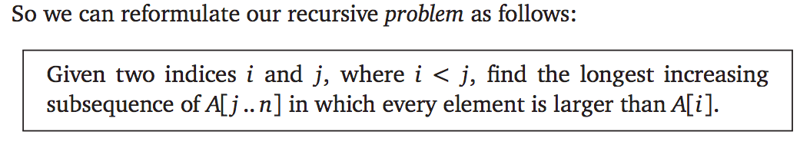
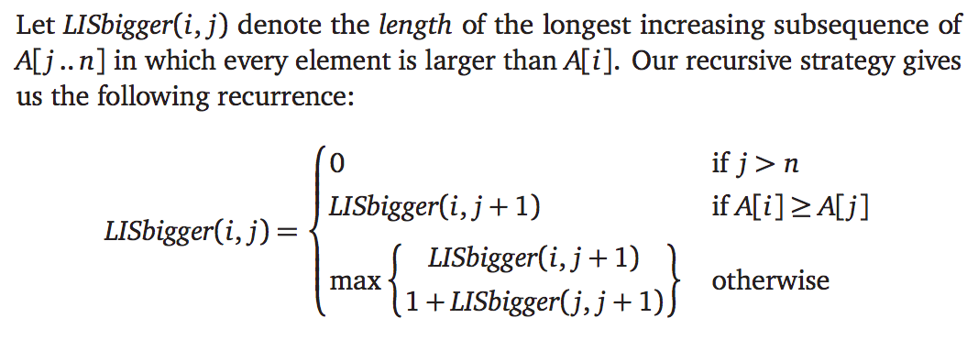
We saw the following..

Slide 17
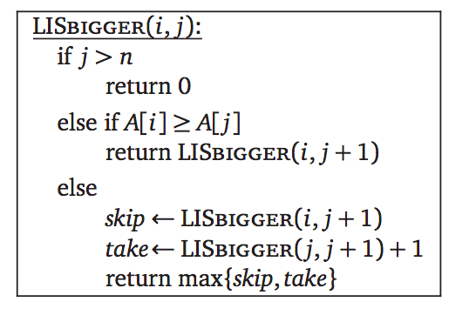
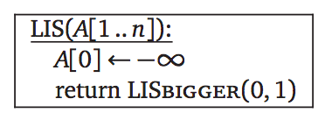
The backtracking algorithm
Finally, we connected our recursive strategy to the original problem: Finding the longest increasing subsequence of an array with no other constraints.
Running time: T(n) = 2T(n-1) + 1, which as usual implies that T(n) = O(2^{n}).

Slide 18
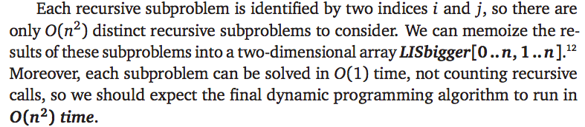

Dynamic Programming

Slide 19
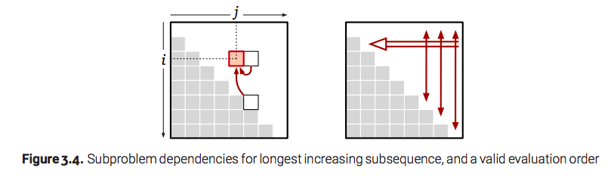
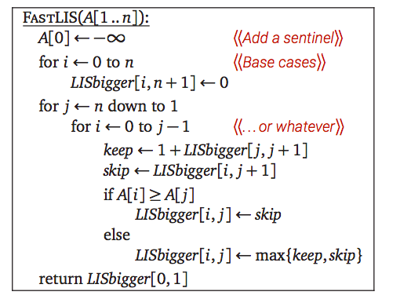
Dynamic Programming Solution

Slide 20
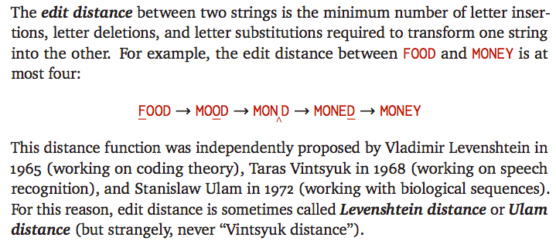
Example: Edit Distance

Slide 21

Example: Edit Distance
Unfortunately, it’s not so easy in general to tell when a sequence of edits is as short as possible. For example, the following alignment shows that the distance between the strings ALGORITHM and ALTRUISTIC is at most 6. Is that the best we can do?

Slide 22
Recursive substructure
Suppose we have the gap representation for the shortest edit sequence for two strings.
If we remove the last column, the remaining columns must represent the shortest edit sequence for the remaining prefixes.
We can easily prove this observation by contradiction: If the prefixes had a shorter edit sequence, gluing the last column back on would gives us a shorter edit sequence for the original strings.
So once we figure out what should happen in the last column, the Recursion can figure out the rest of the optimal gap representation.

Slide 23
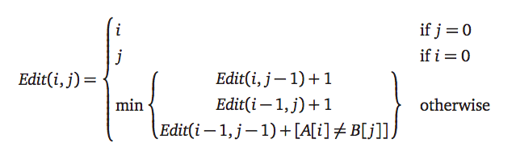
Recurrence

Slide 24
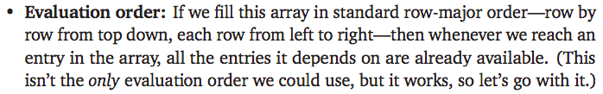
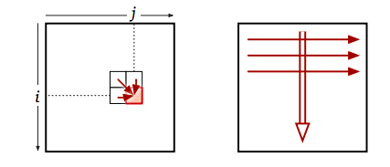
Dynamic Programming

Slide 25
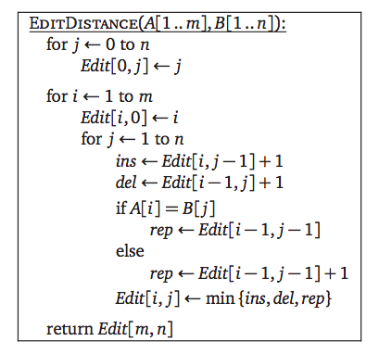
The Algorithm
Space/Time Complexity: O(mn)

Slide 26
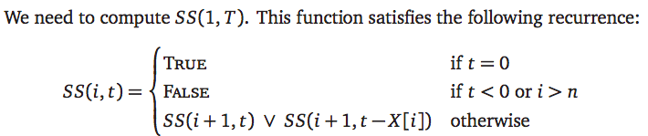
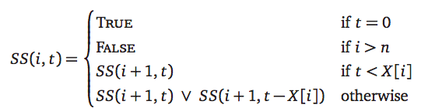
Subset Sum
For Dynamic programming, we want to avoid recursing on t < 0

Slide 27
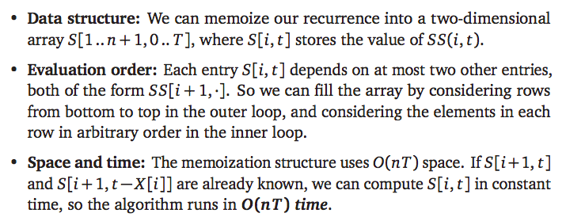
Subset Sum

Slide 28
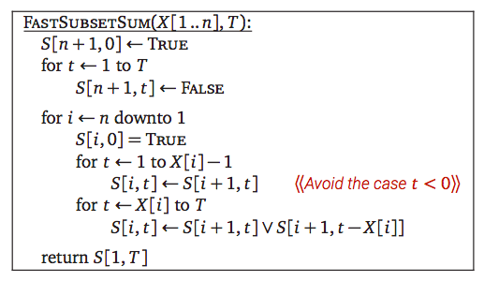
The Algorithm

Slide 29
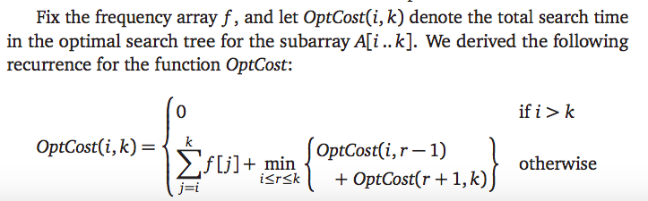
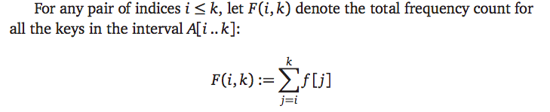
Optimal Binary Search Trees

Slide 30
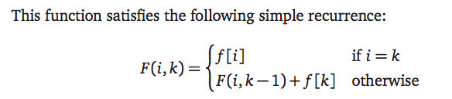
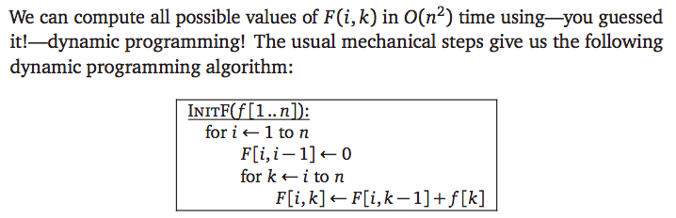
The function F(i,k)

Slide 31
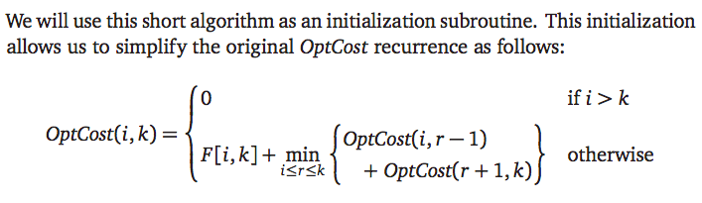
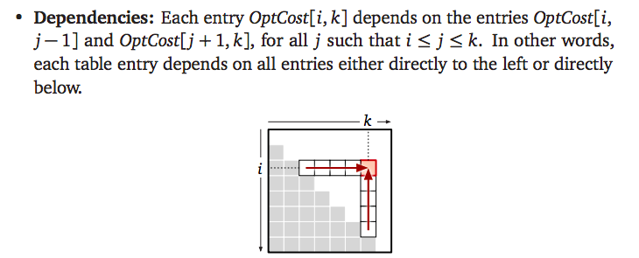
Back to Optimal Binary Search Trees

Slide 32
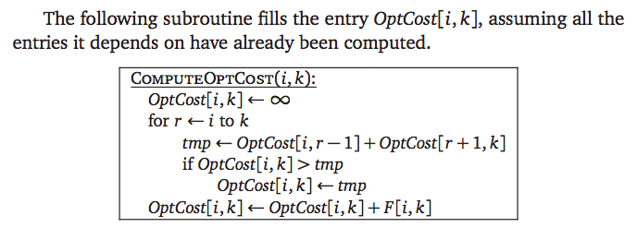
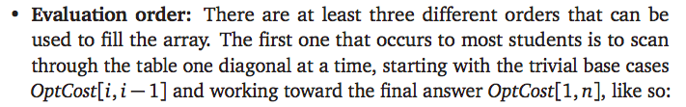
Computing Optimal Cost

Slide 33
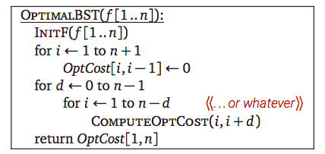
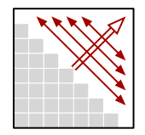

Dynamic Programming Algorithms(s)

Slide 34
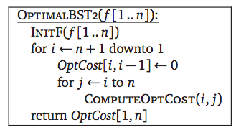
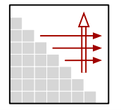
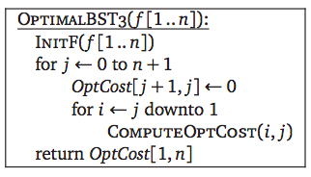
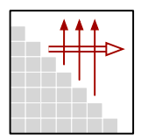
Dynamic Programming Algorithms(s)

Slide 35

Time and Space Complexity

Slide 36
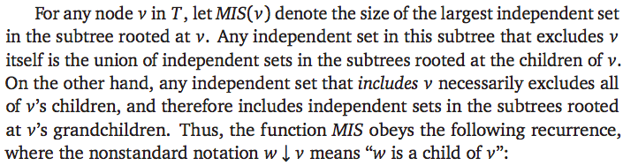
Maximum Independent Set in a Tree

Slide 37
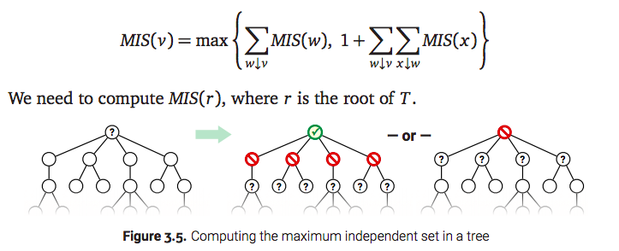
Maximum Independent Set in a Tree

Slide 38
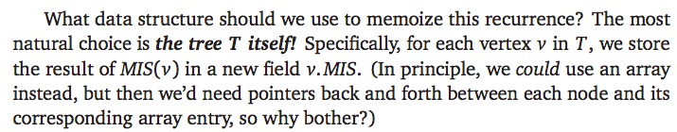
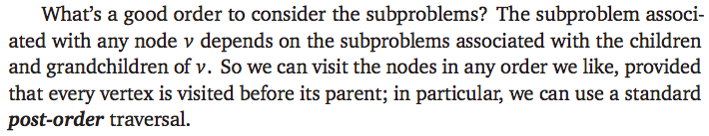
How to Memoize?

Slide 39
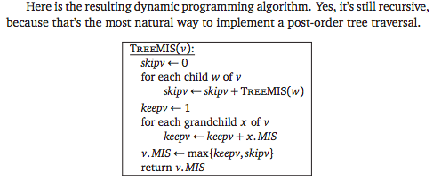
Dynamic Programming Algorithms
What’s the running time of the algorithm? The non-recursive time associated with each node v is proportional to the number of children and grandchildren of v; this is hard to analyze.
But we can turn the analysis around: Each vertex contributes a constant amount of time to its parent and its grandparent! Because each vertex has at most one parent and at most one grandparent, the algorithm runs in O(n) time.

